Slide 1

Recurrent Neural Networks
Recurrent Neural Network Model
deeplearning.ai

Slide 2







Why not a standard network?
$$x^{<1>}$$
$$y^{<1>}$$
$$x^{<2>}$$
$$y^{<2>}$$
$$⋮$$
$$⋮$$
$$⋮$$
$$⋮$$
$$x^{<T_{x}>}$$
$$y^{<T_{y}>}$$
Problems:
Like Music generation / translation
- Inputs, outputs can be different lengths in different examples.
- Doesn’t share features learned across different positions of text.
In particular of the neural network has learned that maybe the word heavy appearing in position one gives a sign that that's part of a person's name, then wouldn't it be nice if it automatically figures out that heavy appearing in some other position x t also means that that might be a person's name. And this is maybe similar to what you saw in convolutional neural networks where you want things learned for one part of the image to generalize quickly to other parts of the image, and we like a similar effects for sequence data as well.
Also, this will have very large input matrix and weight matrix since our one code could have up to 10,000 dimension.

Slide 3
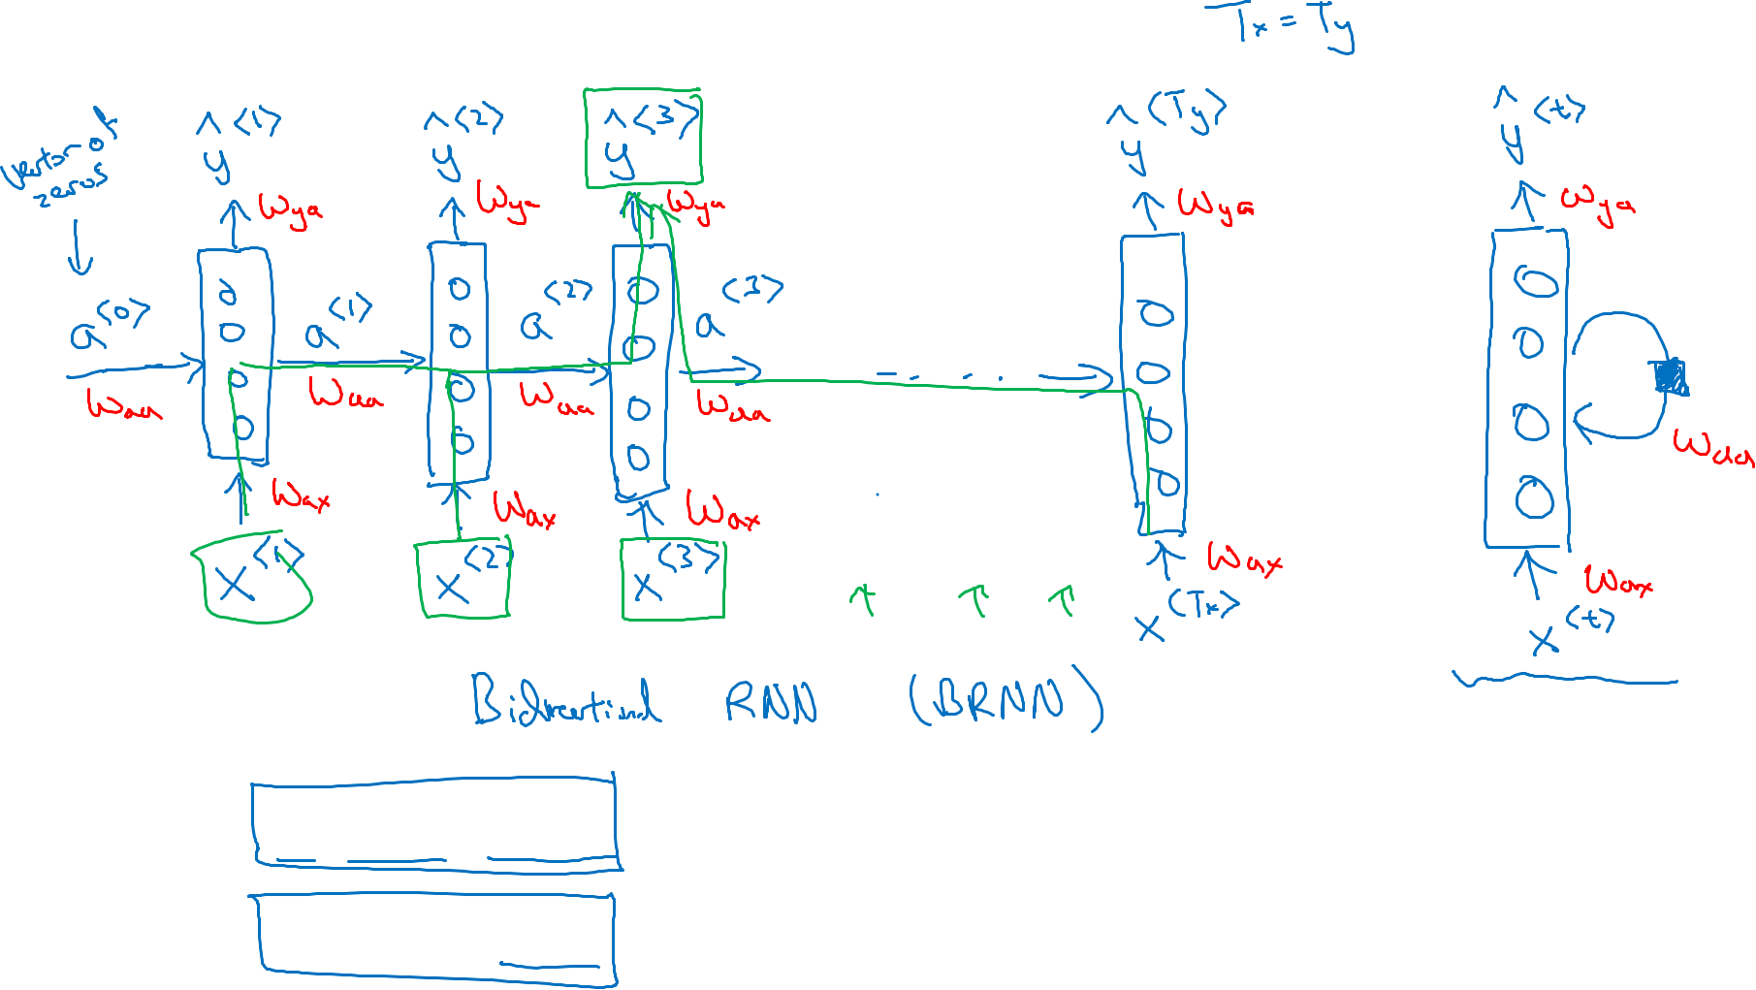
Recurrent Neural Networks
He said, “Teddy Roosevelt was a great President.”
He said, “Teddy bears are on sale!”

Slide 4
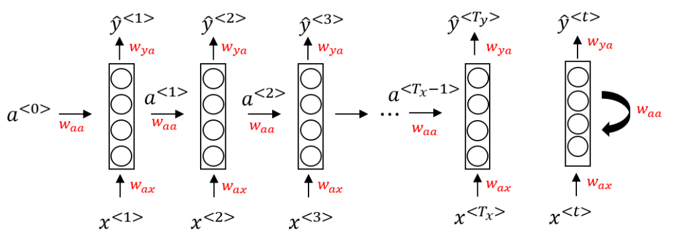
Recurrent Neural Networks
This is a Tx = Ty case
Vector of zero is the most common choice for initialization
Wax is the same for all the word inputs
This is equivalent drawing as on the left hand.
The first word
When predicting the 2nd word, it will not just get the information from x^{<2>}, but also information from 1st word ( a^{<2>})
One weak thing about this NN is it only use s the information that is earlier in the sequence to make a prediction. This will be a problem:
He said, “ Tedd Roosevelt was a great president.”
He said, “ Teddy bears are on sale!”
Without the information of latter word, we cannot say Teddy refers to a person if we just read the first three words.
This will be addressed by bi-directional recurrent neural network ( BRNNs)

Slide 5








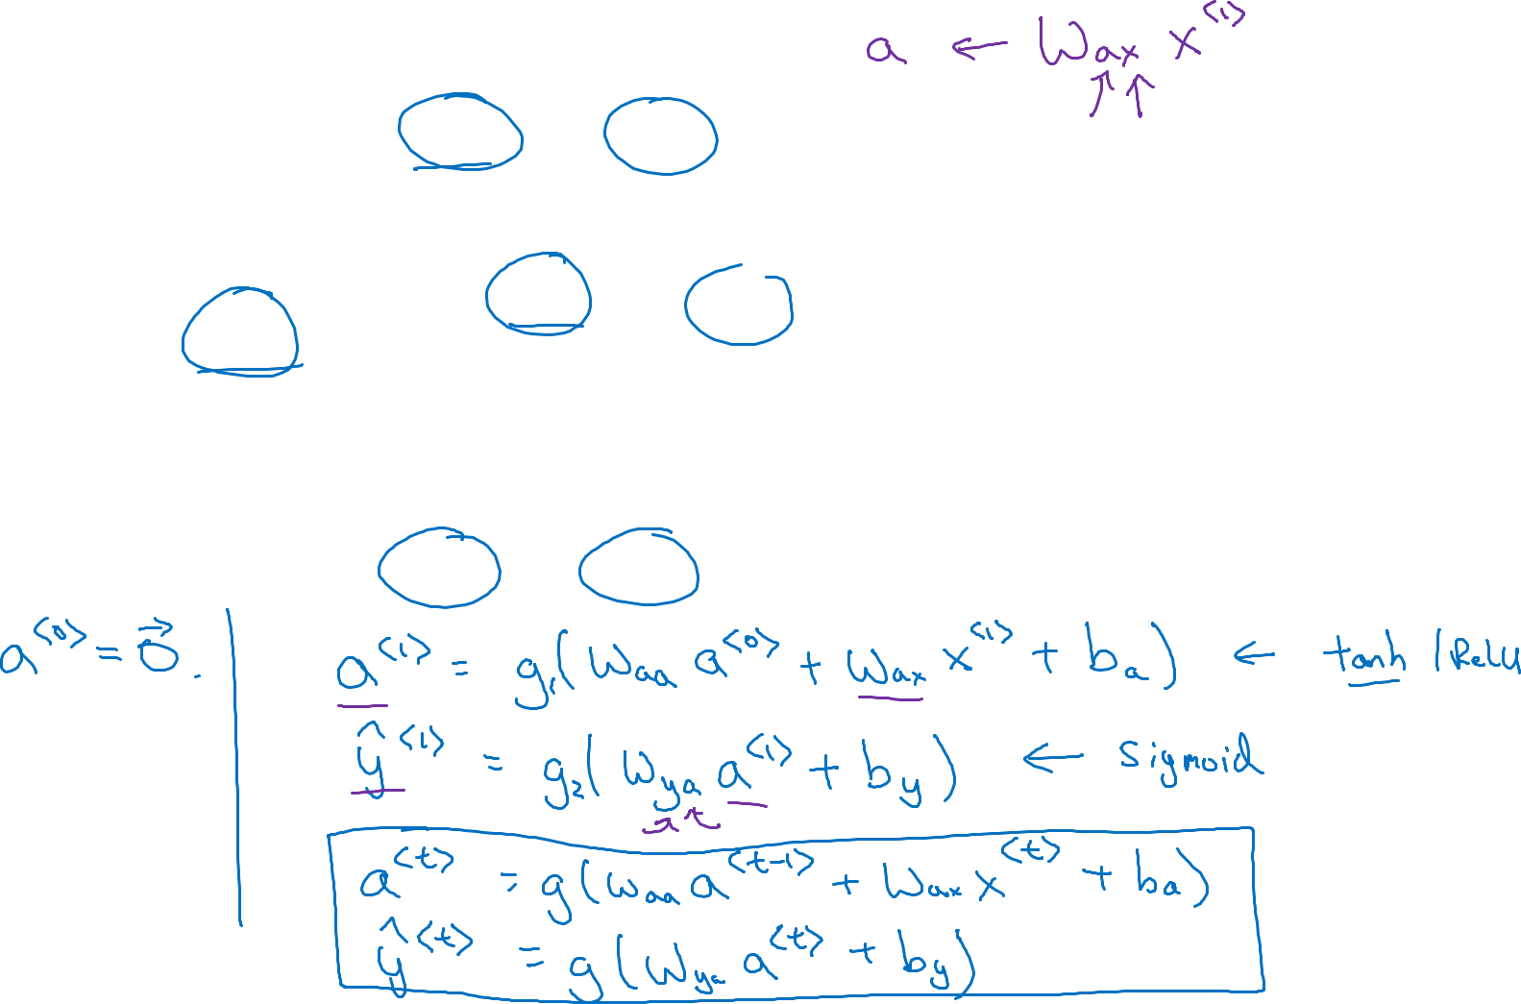





Forward Propagation
x means Wax is going to be multiplied by some X-like quantity
$${\hat{y}}^{<1>}$$
$${\hat{y}}^{<2>}$$
$${\hat{y}}^{<3>}$$
$${\hat{y}}^{<T_{y}>}$$
a means the Wax is going to compute a-like quantity
$$a^{<1>}$$
$$a^{<2>}$$
$$a^{<T_{x}−1>}$$
$$a^{<0>}$$
$$⋯$$
$$x^{<1>}$$
$$x^{<2>}$$
$$x^{<3>}$$
$$x^{<T_{x}>}$$
Binary: sigmoid.
Softmax: multiclass

Slide 6
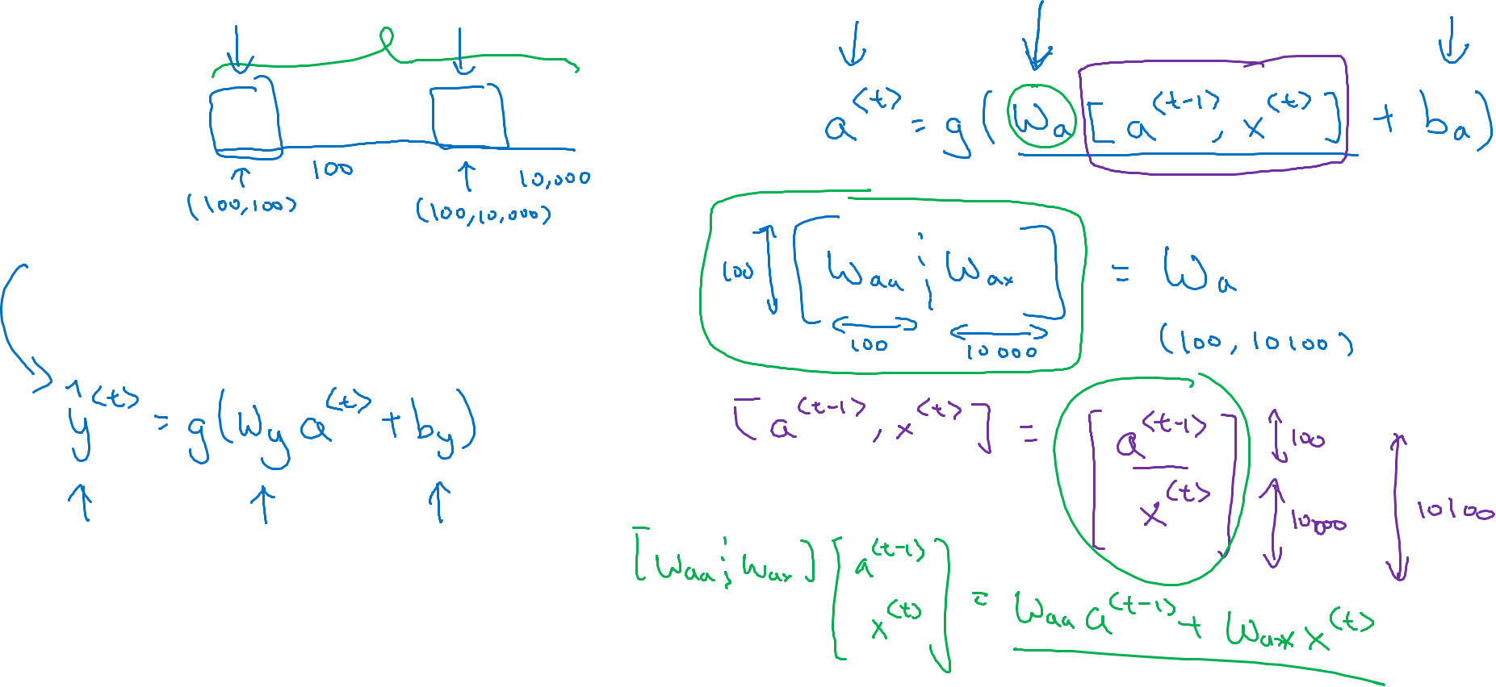

Simplified RNN notation
$$a^{<t>}=g(W_{aa}a^{<t−1>}+W_{ax}x^{<t>}+b_{a})$$
$${\hat{y}}^{<t>}=g(W_{ya}a^{<t>}+b_{y})$$

